Slide 1




The Discovery Project
&
Sesame App Demo
Victor Nouvellet
Visiting Student Researcher at University of California Berkeley
TerraSwarm Research Center
Senior Master Student at Institut National des Sciences Appliquées Lyon
Département Informatique
June 7th, 2017
Notes:
Credit Sesame app : Marten came up with the idea of the name

Slide 2
Outline
Definitions
The Discovery Problem
The Discovery Solution with Accessors
The Sesame App
Implementation and work in progress
Demo
Notes:
I will mainly talk about vision, design and work in progress.

Slide 3
DEFINITIONS

Slide 4
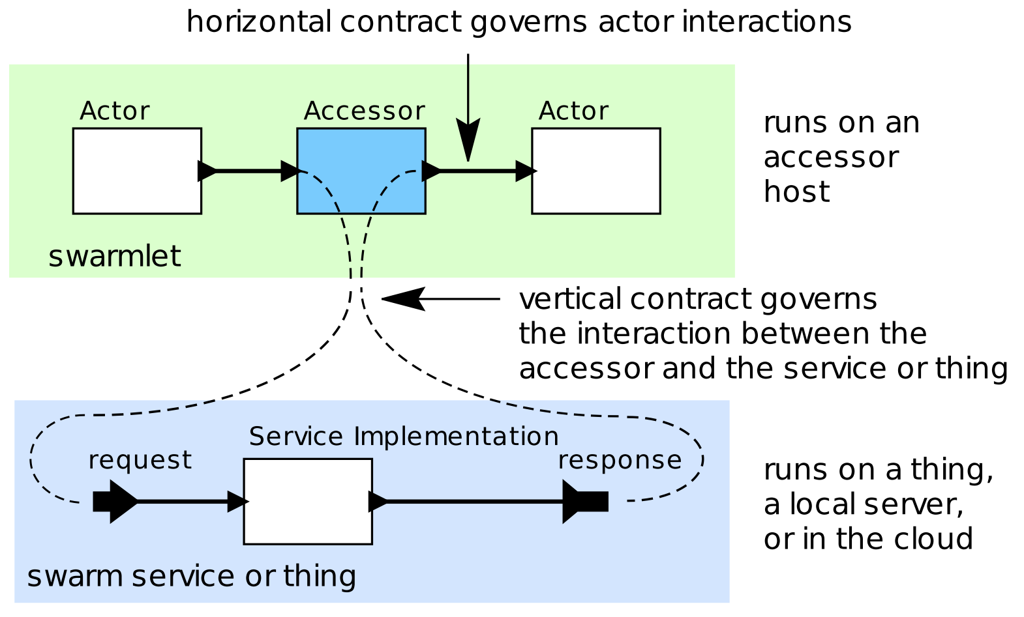
The Accessor Pattern
A composable dataflow actor abstraction of (remote) things or services.
Encapsulates complexity of implementation specifics that hinder composition.
Relies on a standardized execution platform that we refer to as the “host”

Slide 5
The Accessor Host
The host can coordinate the execution of (hierarchical) dataflow networks of accessors.
An important prerequisite for the execution of an accessor is that the host must implement the modules that the accessor requires.
There are a multitude of hosts available: CapeCode (Ptolemy II), NodeJS, DukTape, Browser. commonHost.js implements common functionalities across hosts.
Not all hosts implement the same set of modules.
➝ There is a need for a host on mobile devices : The Cordova Host.

Slide 6
THE DISCOVERY PROBLEM

Slide 7
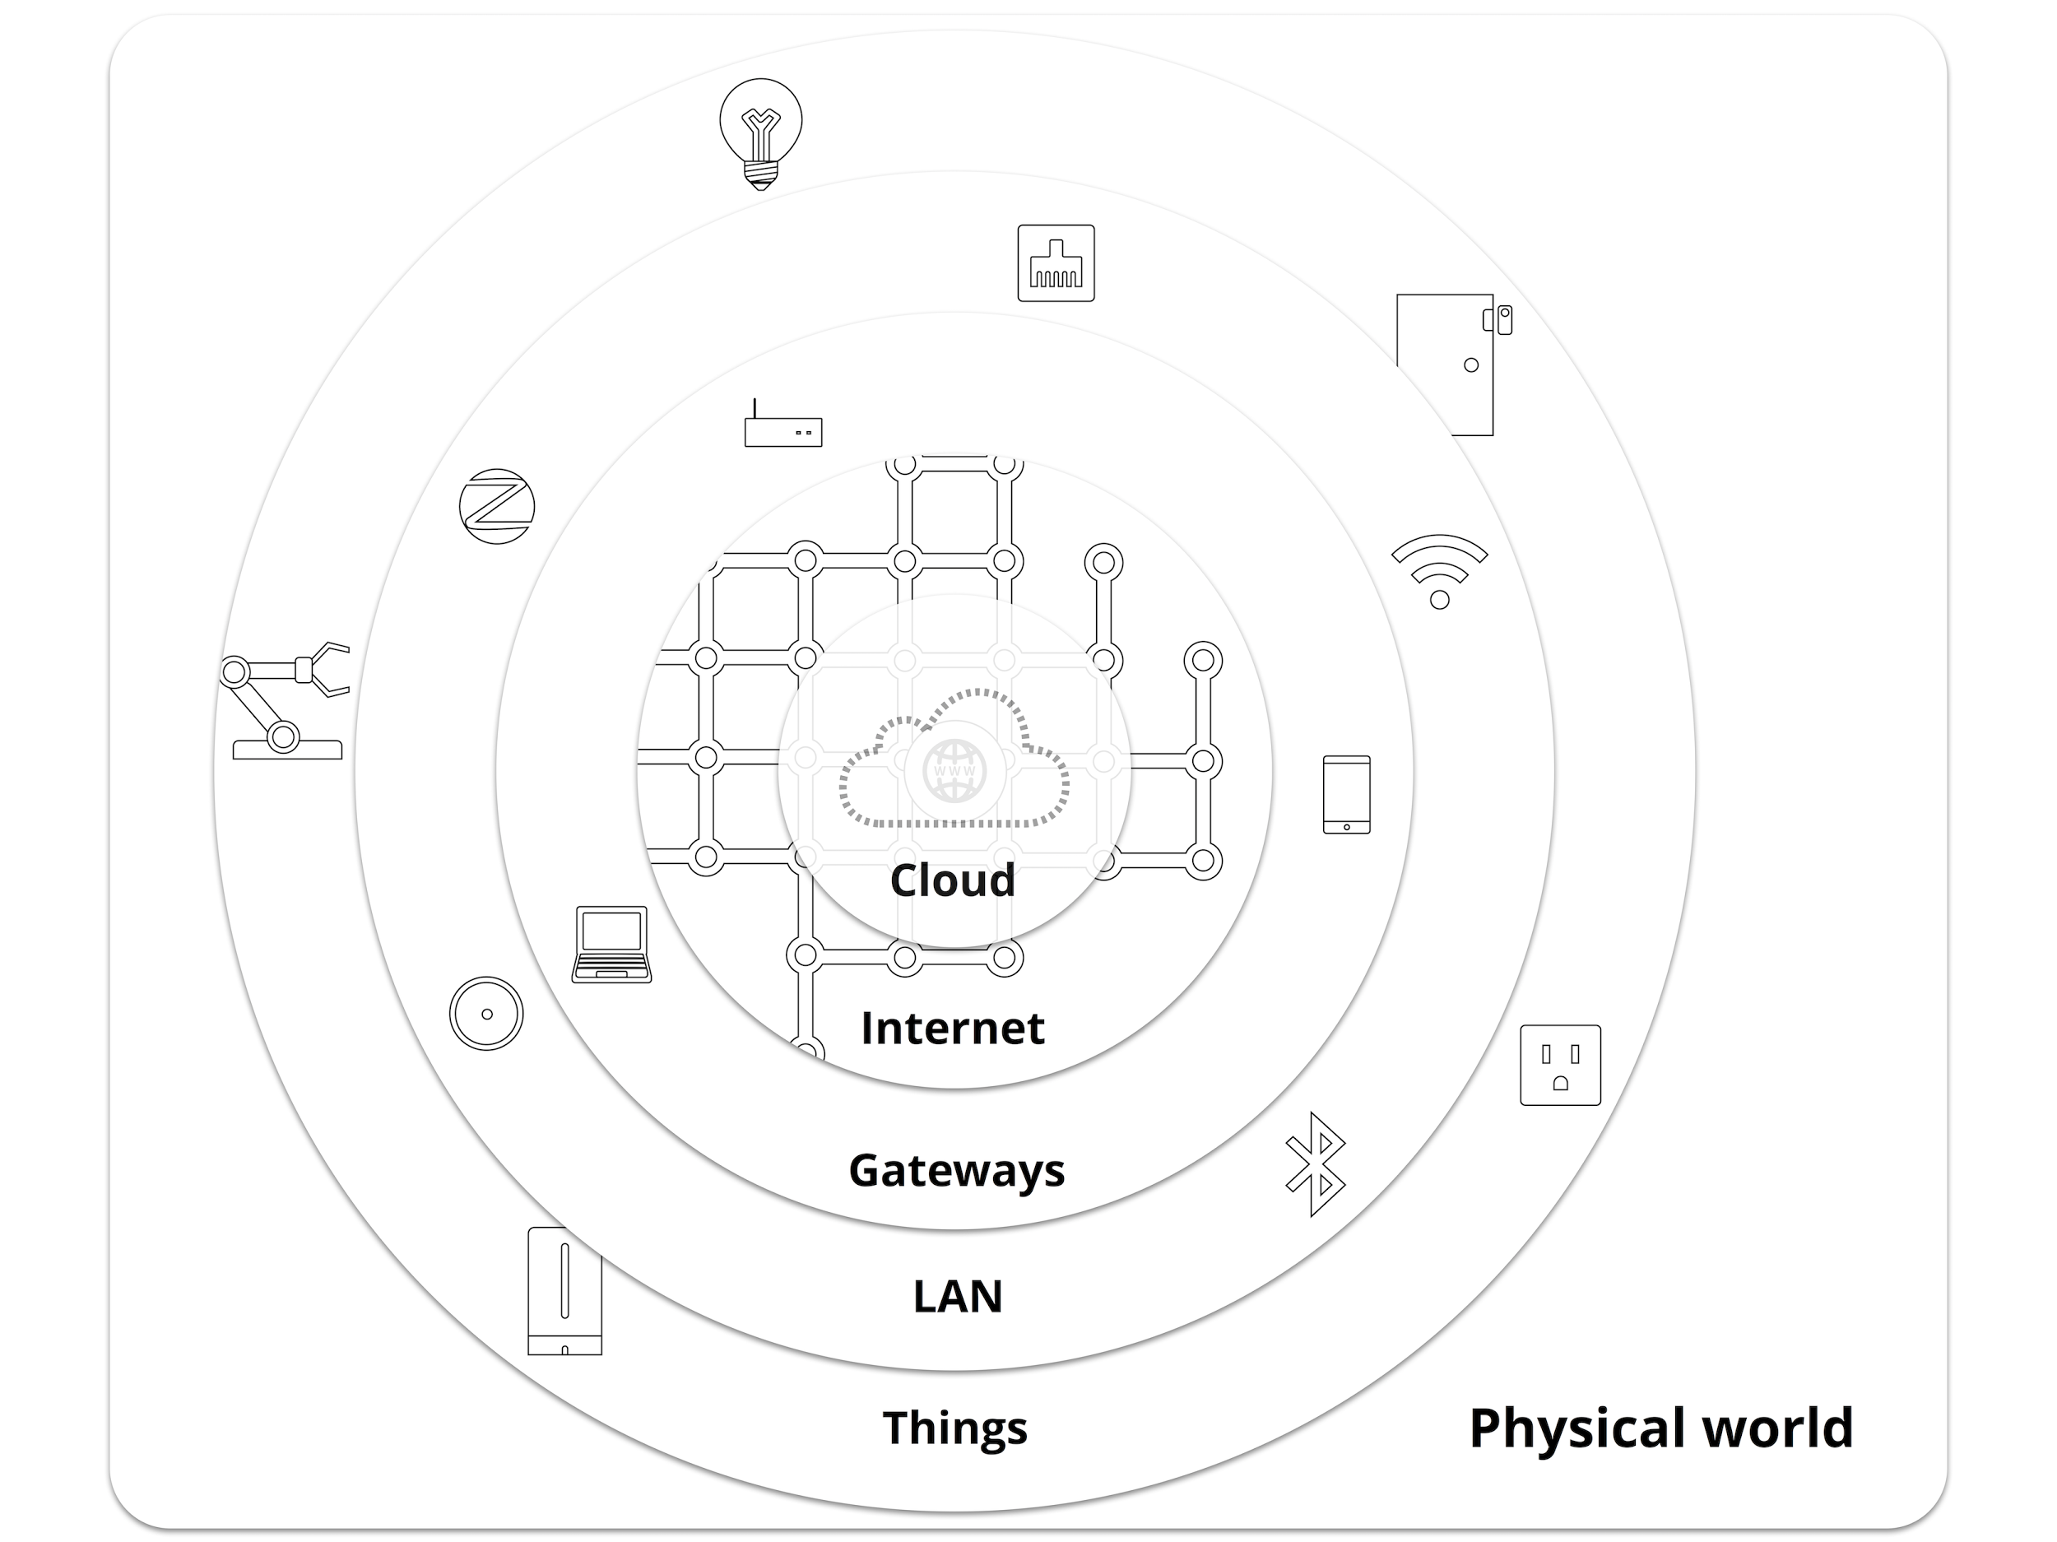
A World of Things
We live in a World of Things that are not organized and provide services.
But to be truly useful, end users need to be able to access them and compose them easily.
Composition should be an everyday life scenario.
“I would like that my light to follow a celebration pattern tonight each time my favorite team is scoring a goal if my TV is off.”
Notes:
This user story needs a completely new mechanism to discover Things around and make the most of their services by combining them. It is what we tried to do at the Terraswarm lab in Professor Edward Lee’s group and the main subject of my internship (?) here.

Slide 8
28.1 billion
# of IoT devices in 2017
But much less people know how to use them...
Source: Statistica
Notes:
We see a bunch IoT devices such as devices for home automation, devices for wellness and fitness management, devices for environmental monitoring, devices for vehicle driving assistance. And it’s growing exponentially

Slide 9
THE DISCOVERY SOLUTION WITH ACCESSORS

Slide 10
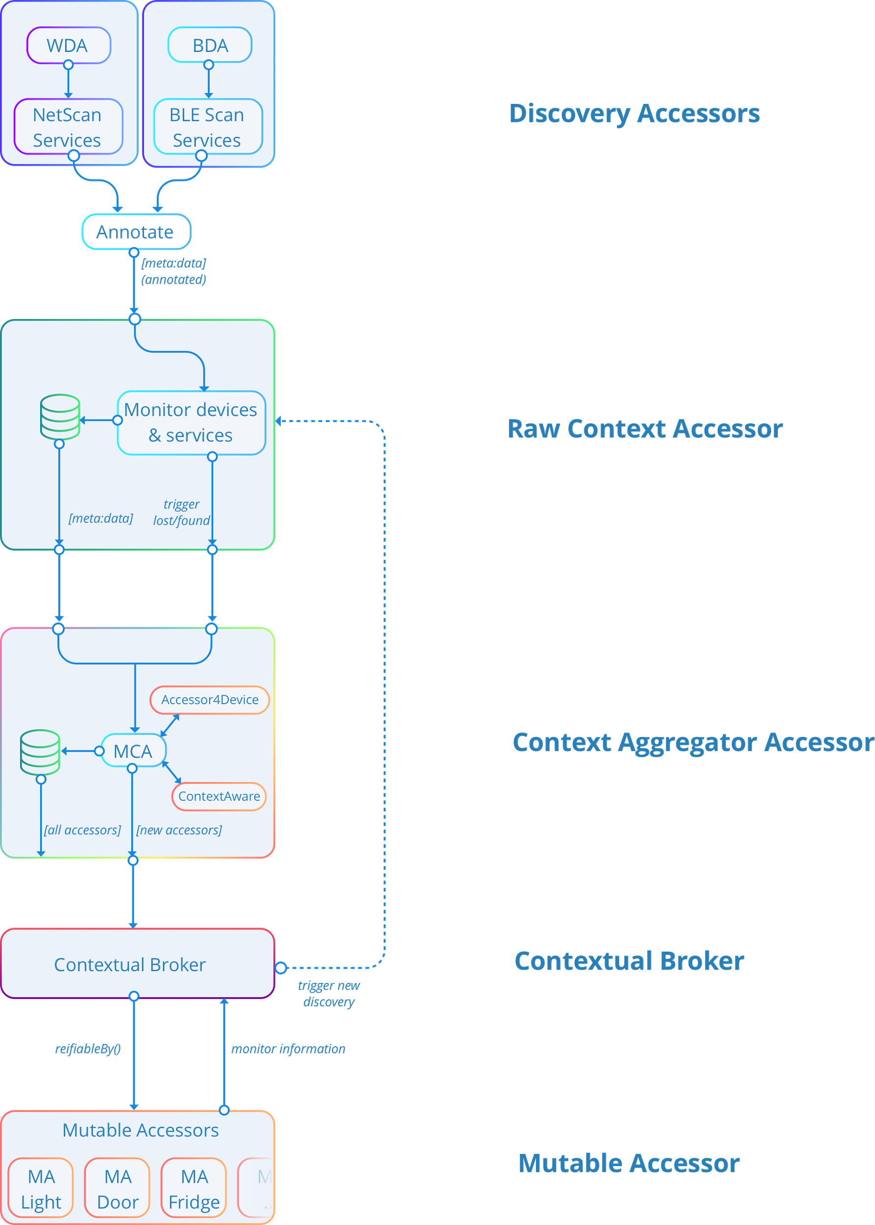
Discovery project in a nutshell
Top-down approach:
Discovery Accessors: Discover devices around
Raw Context Accessor: Monitor connectivity and events
Context Aggregator Accessor: Find and store accessors
Contextual Broker: Classify accessors in user context
Mutable Accessors: Give general definitions of classes of accessors

Slide 11
THE SESAME APP

Slide 12

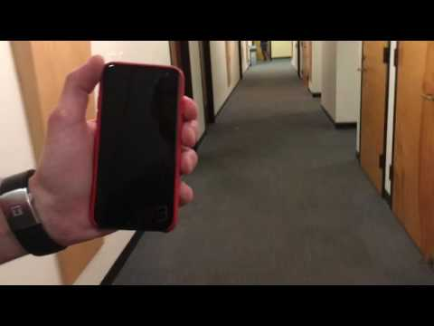
Sesame App (without Accessors)
Notes:
We can skip this slide if everybody remember about it two weeks ago

Slide 13
Sesame App Tasks
“Open the door I am approaching, but remove access to it if I am too far.”
What have to be achieved to reach the goal?
Server side door accessor
SST integration (Hokeun)
Contextual Callbacks (Marten)
Localization (Matt)
Mutable Accessors (Chadlia)

Slide 14
IMPLEMENTATION &
WORK IN PROGRESS

Slide 15
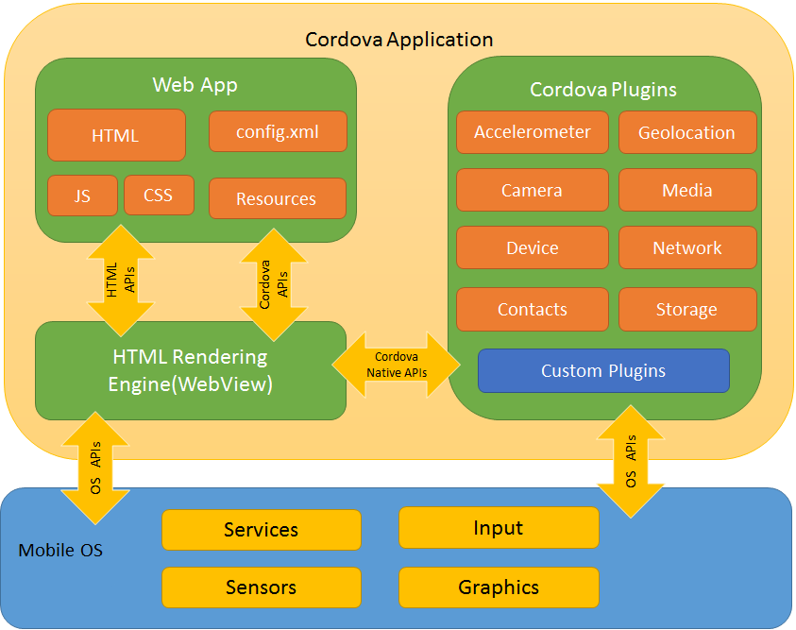
Cordova Architecture
A build Script (build.xml) copy all the accessors and the modules to the generated sub projects
Cordova Host & Accessors
include/cordovaHost.js
include/accessors/
include/modules/
index.js
Plugin ↔ Accessor Module association
Source : https://cordova.apache.org/docs/en/latest/guide/overview/

Slide 16
Use of the Cordova Host
Use a swarmlet on a unique host running on different platforms
Tasks:
commonHost.js has been leveraged by cordovaHost.js
The Cordova host now has the first modules implemented and working
A key task towards making the Cordova host useable is to port the modules that are supported on other hosts.
Basic functionalities have been tested

Slide 17
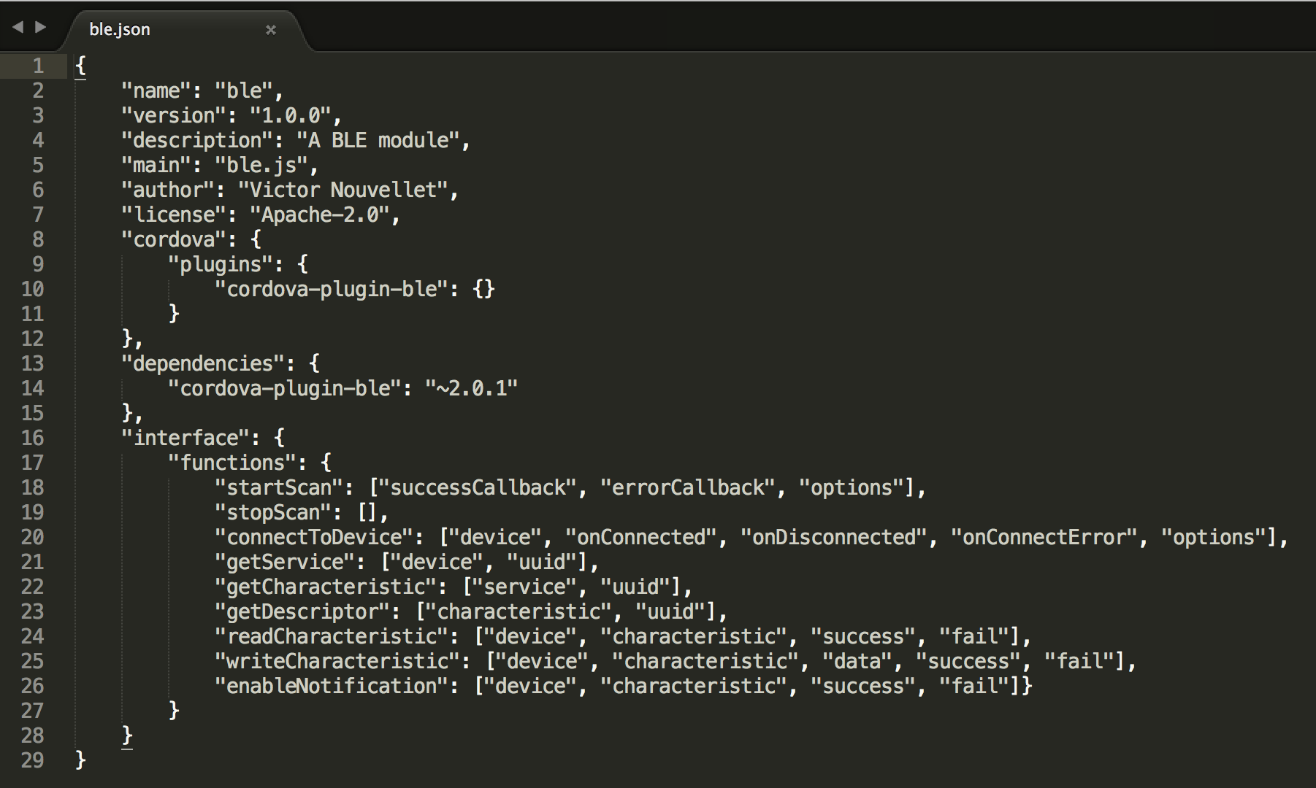
Proposal: Modules Metadata
Have a JSON description file for each module like in Node.js projects :
Ex: The ble.js module comes with ble.json
The X.json file provides:
Interface description (functions & properties)
Dependencies (in our case, cordova plugins)
Extra information (author, description, etc...)
The version of the module

Slide 18
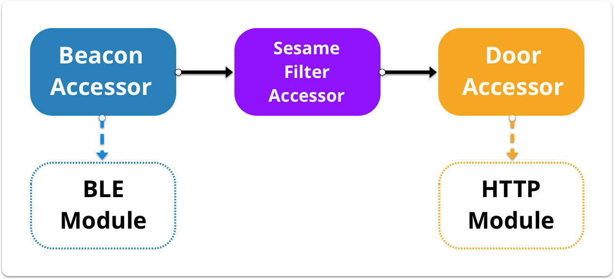
Latest Cordova implementations
Modules (host dependant):
A BLE module to discover BLE devices ⇄ cordova-plugin-ble
A HTTP Client module to make HTTP requests ⇄ cordova-plugin-http
Accessors (host independant):
BLE accessor ⇄ BLE module
Door accessor ⇄ HTTP Client module
SesameFilter accessor
⇨ Sesame Swarmlet
Notes:
A BLE module to discover BLE devices, their characteristics and connect to them. It communicate with the cordova-plugin-ble plugin.
A HTTP module to make HTTP requests. It communicate with the cordova-plugin-http plugin.
The BLE accessor, which communicate with

Slide 19
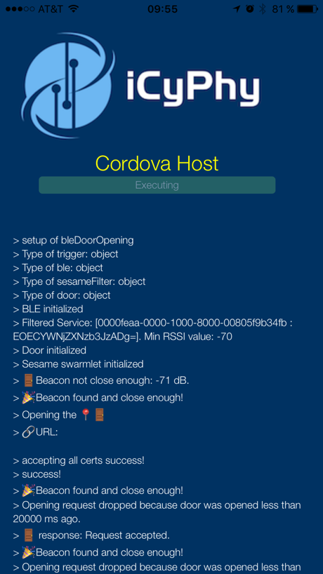

Slide 20

DEMO
Made possible by the joint work of Chadlia Jerad, Marten Lohstroh, Hokeun Kim, Matt Weber and me

Slide 21

Thank everyone!
It has been an amazing journey

