Slide 1
Splash 2 – ASIC Spectrometer
Stevo Bailey
September 10, 2014

Slide 2
Design Assumptions
Polyphase spectrometer
I and Q inputs, sideband separating
10 GHz bandwidth
16384 channels
Integrate spectrum power for ≥ 1ms

Slide 3
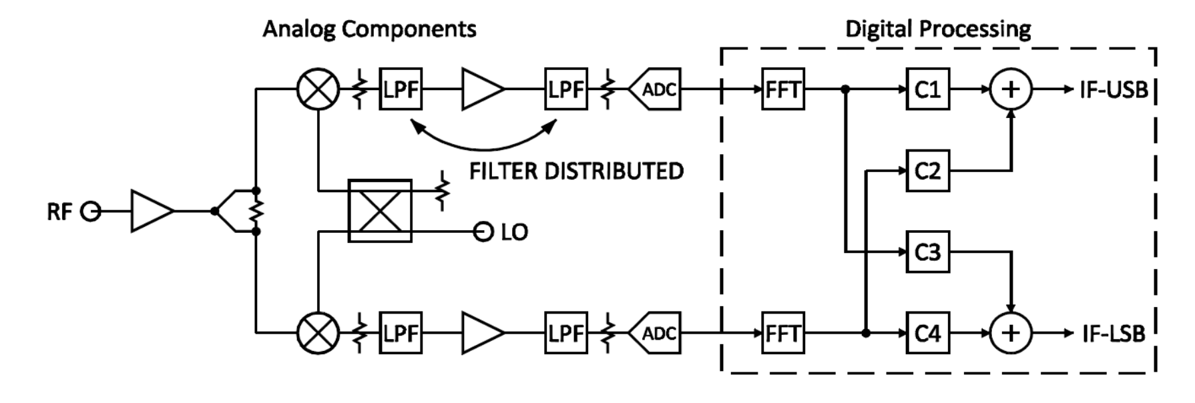
Design Overview

Slide 4
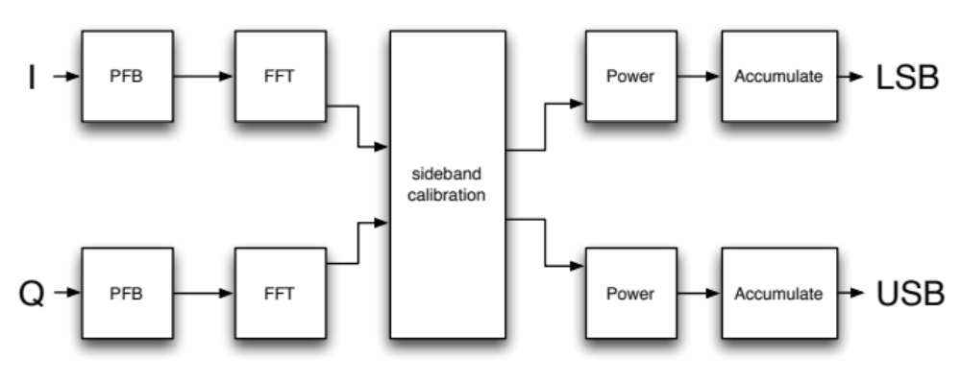
Design Overview

Slide 5
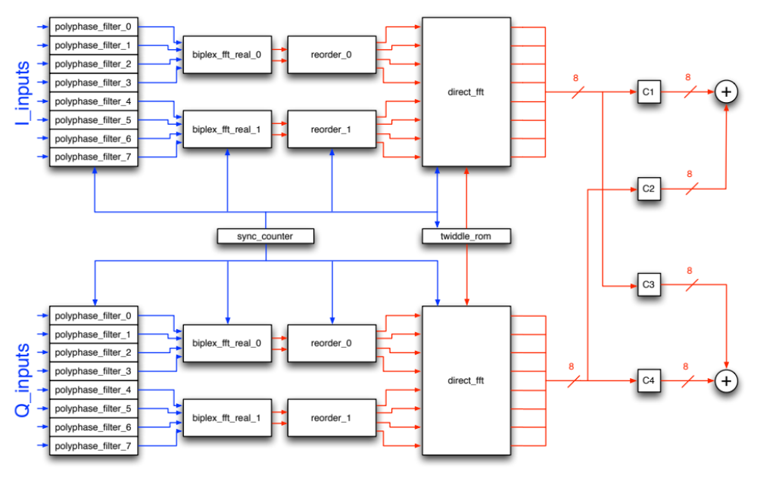
Design Details

Slide 6
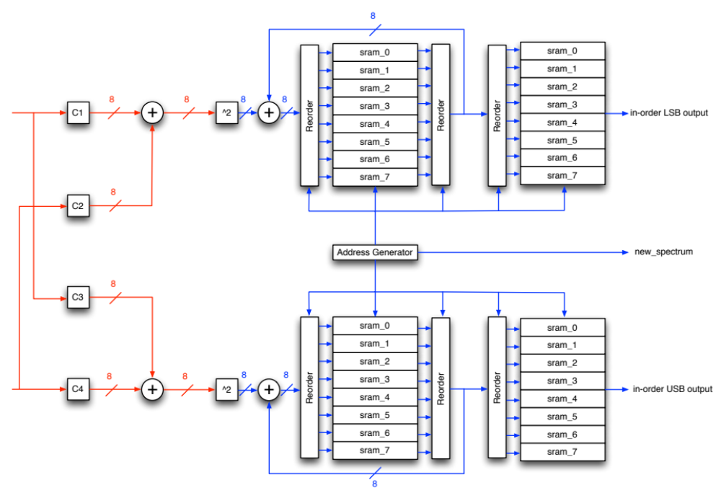
Design Details

Slide 7
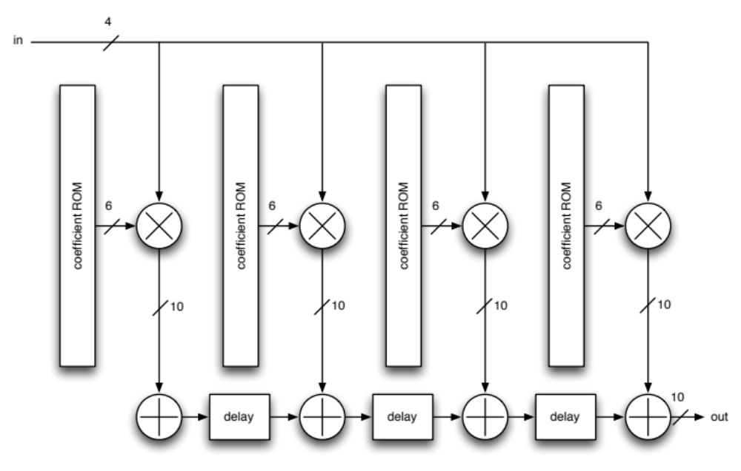
Polyphase Filter
4-tap FIR filter
each tap needs different coefficients
each filter needs different coefficients
Notes:
direct form better here?

Slide 8
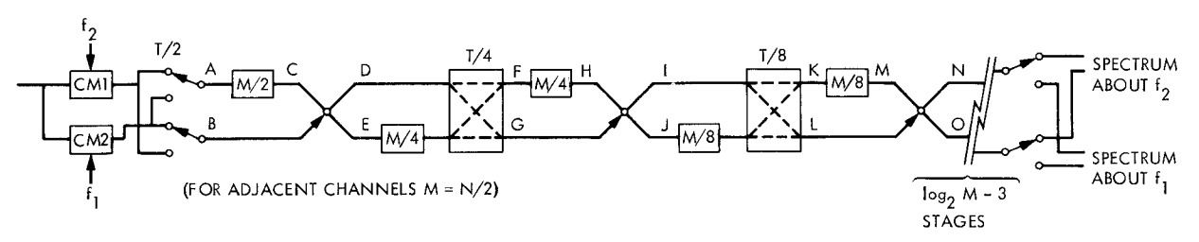
Biplex FFT Real
butterfly
shift registers
MUXes
real inputs applied to real and imaginary inputs
  reduces number of biplex cores needed
  must reorder outputs either before or after direct FFT
log2(N) butterflies
numerous long shift registers (as SRAMs)
bitwidth growth, 1 bit per stage from 10 to 16, then truncate every stage

Slide 9
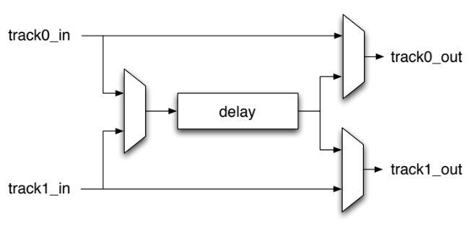
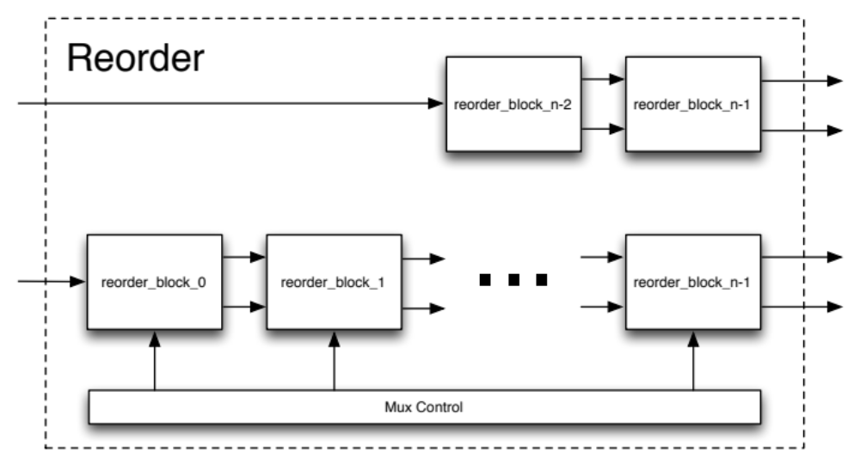
Reorder Block
reorders outputs before direct FFT
also performs one more complex multiply and add at output
MUX control is ROM because I couldn’t find a nice pattern
delays implemented as 32-bit SRAMs
utilization: 50%

Slide 10
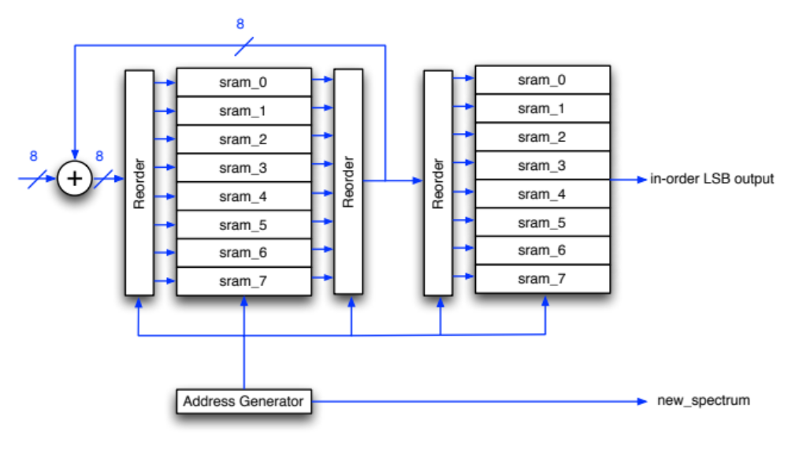
Accumulator
8 inputs coming in, so need 8 64-bit SRAMs
shuffles the inputs to finish reordering (optional)
all SRAMs have n/p/2 words
one extra register for DC term
asynchronous read-out
accumulation triggered by control signal
integration time set by control signal

Slide 11
Matlab Results
input written to file and read into Matlab
  polyphase filter and FFT applied in MATLAB when necessary
output written to file and read into Matlab
  reordered when necessary in Chisel TB
  also filtered in Matlab when necessary

Slide 12
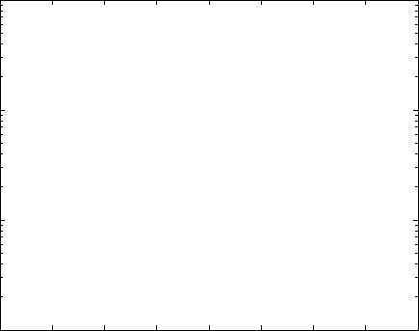
Matlab Results

Slide 13
Splash as Hurricane use case
Splash Advantages
  extremely scalable
  streaming DSP algorithm
Splash Disadvantages
  many large memories (handling by Hurricane?)
  no automatic testbench yet

